Slide 1
초소형 SAR 위성 시스템
2020. 03. 05

Slide 2
Agenda
Project Overview
  Mission Objective
  Satellite Configuration
  Development Baseline
  Major Milestone
  Roles & Responsibility

Slide 3
Agenda
System Overview
  Concept of Operations
  H/W Development Baseline
    Development Model Concept
    Redundancy Concept
  Satellite Architecture
  Payload Architecture
  Spacecraft
  Ground Segment
  Launch Vehicle
    Bidding Schedule for Launch Vehicle Selection

Slide 4
Agenda
Concept of Operation
  System Operations Overview
  Orbit Design and Characteristics
    Mission Orbit
    Ascending Node Pass (Dawn)
    Ascending Node Pass (Dusk)
    GS Contact Characteristics
  System Operation
    System Operation Phase
    Satellite Operation Mode
  Payload Operation Mode
  GS Operation
    Mission Planning and Scheduling
    Command and Control
    Telemetry Reception and Processing
    Mission Support Operations
    Flight Dynamics Operations
    Payload Data Collection, Processing, and Production Generation
    Calibration and Validation Operation

Slide 5
Agenda
Mission Analysis
  Orbit Analysis
  Attitude Analysis
  Energy Balance Analysis
  Link Analysis

Slide 6
Agenda
System Engineering
  Specification Tree
  System Requirements
    Requirements Allocation
    TBD/TBR/TBC List
  System Budget Control
    Definition and Allocation
    Image Quality Budget
    Pointing Budget
    Mass Budget
    Power Budget
    S-band Link Budget
    X-band Link Budget
    Propellant Budget
    Reliability

Slide 7
Agenda
System Engineering (Cont'd)
  Interface
    Interface between Payload and Spacecraft Bus
    Launch Vehicle Selection and Interface
      Mission Design Interface
      Electrical Interface
      Mechanical Interface
      Environment Interface
    Space to Ground Interface
      S-band Interface
      X-band Interface
  EMI/EMC Design
  Verification Plan
    Verification Overview
    Verification Management
    Requirement Verification Matrix (RVM)
    Requirement Traceability Matrix (RTM)
    Verification Test Matrix (VTM)

Slide 8
Agenda
Payload System
  SAR Payload Major Requirements
  Configuration
  Function Block Diagram
  SAR Sensor Electronics
  SAR Antenna Subsystem
  Data Link Subsystem

Slide 9
Agenda
Spacecraft Bus System
  Spacecraft Bus Major Requirements
  Configuration
  Function Block Diagram
  Mechanical Design Integration
  Electrical Design Integration
  Structures and Mechanism Subsystem
  Thermal Control Subsystem
  Attitude and Orbit Control Subsystem
  Propulsion Subsystem
  Telemetry, Command, and Ranging Subsystem
  Electrical Power Subsystem
  Flight Software Subsystem

Slide 10
Agenda
Ground Segment
  Architecture
  Mission Control Element (MCE)
  Image Reception and Processing Element (IRPE)
  Calibration and Validation Element (CVE)
  SAR Processor
Assembly, Integration, and Test
Electrical Test Bed

Slide 11
Project Overview

Slide 12
Mission Objective
Real Time Global Observation
GIS: Acquisition of independent high resolution SAR images
Surveillance : Maritime Vessel Monitoring & Preventing Illegal Fishing
Ocean & Land Management: Survey of natural resources
Disaster & Environment Monitoring: large scale disasters & Ice
Small SAR Satellite
SAR Data Processing
SAR Satellite Operation

Slide 13
Satellite Configuration
초소형 SAR 위성 형상안
<형상안>

Slide 14
Development Baseline
Space Segment
  One FM Satellite
    One FM Spacecraft Bus
    One FM LSS[TBC] Payload
Ground Segment
  One MCE
  One IRPE (One set of SAR Processor)
  One CAL/VAL Element
Ground Support Equipment, etc.
  Spacecraft and I&T
    One set of ETB, STM
    One set of MGSE & EGSE
  LSS Payload
    One Set of LSS EQM
    One Set of LSS Payload EGSE

Slide 15
Major Milestone
Milestone | Description | Date | Remark
Kick-Off | Project Overview | 2020. 03.02
SRR | Mission Requirements | 2020.03. 20
SDR | Concept of Operation Mission Analysis Result System Design Result | 2020. 04.30
PDR | Subsystem Design Result EGSE | 2020. 07. 30 | EM(Antenna)
CDR | Unit Level Design Result | 2020. 12. 30 | EQM(Payload)

Slide 16
Roles & Responsibility
Role |  | RLE | RDE
Project Manger |  | 남명용
Product Assurance |  | 조성운
System | EDI | 오대수 | 우무현, 박상섭
 | MDI | 김민석
Payload | Digital | 오대수 | 박양수, 박정태,이창수
 | RF | 우무현 | 박창서
Bus |  |  | 박상섭(AOCS) | Will be assigned
GS |  |  | 양희인(SDPA) | Will be assigned

Slide 17
System Overview

Slide 18
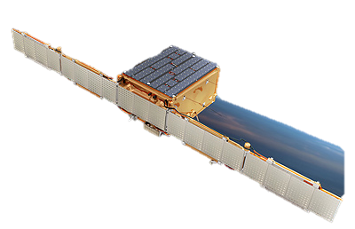
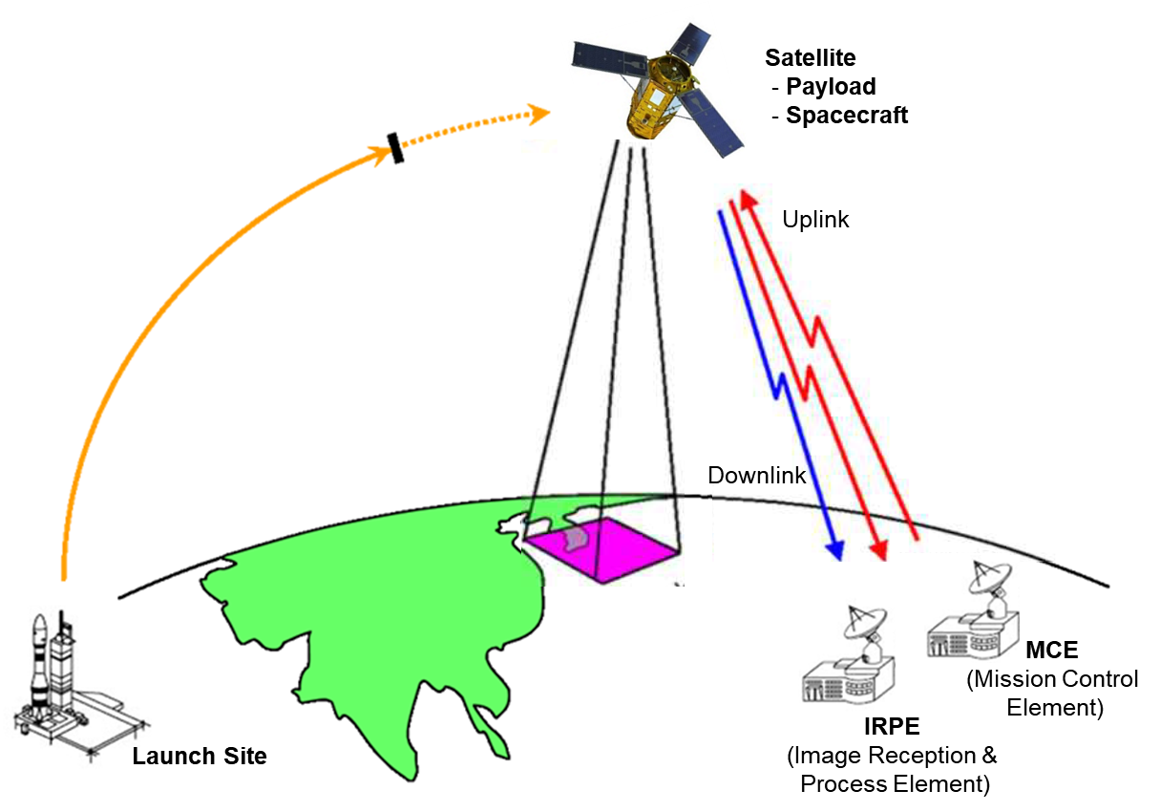
Concept of Operation
Satellite
Spacecraft Bus
Payload (SAR)
Ground Station

Slide 19
System Requirements
Requirements Allocation
순번 | 항목 | 설계규격 | 비고
1 | SAR 분해능 | Az : < 1 m, Rg : < 1 m | TBD
2 | 고도 | 505 km | TBD
3 | 궤도 | 태양동기궤도 | TBD
5 | 궤도당 최대 영상획득 시간 | > 60 s , Duty < 1% | TBD
6 | 관측 모드 | Stripmap | TBD
7 | 관측폭 | Stripmap : > 70km | TBD
8 | 관측 경사각 | 25° ~ 31° | TBD
9 | SAR 영상자료 저장 | - | TBD
10 | Downlink 전송속도 | 320 Mbps | TBD
11 | 자료 암호화 | - | TBD
12 | 이중화 | Board Level 기준 | TBD
13 | 편파 | V-pol. | TBD
14 | 주파수 | 9.66 GHz | TBD
15 | Chirp 대역폭 | > 300 MHz | TBD
16 | Chirp 생성방식 | DDS, Memory map | TBD
17 | 소비전력 | < 600 W | TBD
18 | 무게 | < 80 kg | TBD
19 | 크기 | At Launch : 0.6 m x 0.6 m x 0.8 m In Orbit : 3.2 m x 0.6 m x 0.8 m | TBD
20 | 환경조건 | 진동, 충격, EMC, 온도 | TBD

Slide 20
  H/W Design Baseline
Development Model
  기준: EQM, FM
  예외: EM, QM, FM (Antenna)
Redundancy Concept
  기준: No Redundancy
  예외: Board level Redundancy (Bus(OBC), Payload(SCM)) [TBC]
Standard I/F
  Power : +28V
  TMTC: SpW, CAN
  PPS: RS422
  Protocol: CCSDS Compatible
  Box Internal : SpaceVPX
Part Selection
  기준: IND Grade
  예외: MIL Grade (DC/DC, Regulator, OSC) [TBC]

Slide 21
Satellite Architecture
초소형 SAR 위성 시스템 구성
초소형 SAR 위성
Bus
Payload
TC&R
(Telemetry Command &
Ranging Subsystem)
AOCS
(Attitude & Orbit
Control Subsystem)
EPS
(Electrical Power
Subsystem)
SMS
(Structure &
Mechanism Subsystem)
SAR
XDAA
(X-Band Downlink
Antenna Assembly)
SCEU
(SAR Control
Electronics Unit)
SATA
(SAR Antenna &
TRM Assembly)
Level I
Level II
Level III
Level IV

Slide 22
Satellite Architecture
초소형 SAR 위성 시스템 구성
초소형 SAR 위성
Payload
SAR
XDAA
(Downlink Antenna Unit)
IF-Band
Mission
Data
SCEU
(SAR Control Electronic Unit)
X-Band
Tx/Rx
Chirp
SATA
(SAR Antenna &
TRM Assembly)
TM/TC
TM/TC
Real Time
Control
Power
Control
Power
Control
TM/TC
Bus
Power
Control
PPS
28 VDC
TC&R
(Telemetry Command & Ranging Subsystem)
28 VDC
EPS
(Electrical Power Subsystem)
TM/TC
DC Power
28 VDC
SMS
(Structure & Mechanisms Subsystem)
AOCS
(Attitude & Orbit Control Subsystem)

Slide 23
Payload Architecture
SAR Payload 구성
Payload
SAR
XDAA
(X-Band Downlink Antenna Assembly)
SCEU
(SAR Control Electronics Unit)
SATA
(SAR Antenna & TRM Assembly)
SAR S/W
XDA
(X-Band Downlink Antenna)
PSD
(Power Supply for Digital)
SAM #0 ~ #5
(SAR Antenna Module)
RTEMS
XPA
(X-Band Power Amplifier)
SCM
(SAR Control Module)
TRM #0 ~ #5
(Transmit / Receive Module)
SAR Mission Scheduler
XUC
(X-Band Up Converter)
DMM
(Downlink Modulation Module)
TPD
(Tx Power Divider)
Downlink Scheduler
XPM
(X-Band Downlink Power Module)
FMM
(Flash Memory Module)
RPC
(Rx Power Combiner)
SGR
(SAR Signal Generation & Receiving Module)
FSC
(Frequency Synthesis & Conversion Module)
Level II
Level III
PSA
(Power Supply for Analog)
Level IV
Level V

Slide 24
Payload Architecture
SAR Payload 구성
Bus
Payload
SAR
XDAA
(X-Band Downlink
Antenna Assembly)
SCEU
(SAR Control Electronic Unit)
SATA
(SAR Antenna & TRM Assembly)
PSD
(Power Supply for Digital)
SAM #0
(SAR Antenna Module)
XDA
(X-Band Downlink Antenna)
TM/TC
SCM
(SAR Control Module)
TM/TC
TRM #0
(Transmit / Receive Module)
XPA
(X-Band Power Amplifier)
Power
Control
DMM
(Downlink Modulation Module)
Power
Control
•
•
•
IF-Band
Mission
Data
XUC
(X-Band Up Converter)
FMM
(Flash Memory Module)
SAM #5
(SAR Antenna Module)
XPM
(X-Band Downlink
Power Module)
SGR
(SAR Signal Generation &
Receiving Module)
TRM #5
(Transmit / Receive Module)
Real time
Control
FSC
(Frequency Synthesis &
Conversion Module)
TPD
(Tx Power Divider)
PSA
(Power Supply for Analog)
X-Band
Tx/Rx
Chirp
RPC
(Rx Power Combiner)
TM/TC
Power Control
PPS
28 VDC

Slide 25
Payload Architecture
SAR Payload 구성 – SCEU 상세
Bus
SCEU (SAR Control Electronics Unit)
SATA
(SAR Antenna &
TRM Assembly)
+28 V
PSD
(Power Supply for Digital)
Secondary
Voltage
Power Control
Secondary
Voltage
Power
Control
TM/TC
SCM
(SAR Control Module)
TM/TC
PPS
Power Control
Monitoring
(Temp, Voltage)
Power
Control
DMM
(Downlink Modulation Module)
TM/TC
Mission
Data
FMM
(Flash Memory Module)
XDAA
(X-Band Downlink
Antenna Assembly)
Mission
Data
SGR
(SAR Signal Generation &
Receiving Module)
Real Time Control
IF-Band
Rx Chirp
IF-Band
Tx Chirp
X-Band Tx Chirp
(Direct Generation)
Power Control
IF-Band
Mission Data
FSC
(Frequency Synthesis &
Conversion Module)
TM/TC
X-Band Tx Chirp
Mission Data
X-Band Rx Chirp
+28 V
Ref. Clock
Secondary
Voltage
PSA
(Power Supply for Analog)
+28 V

Slide 26
Payload Architecture
SAR Payload 구성 – SATA 상세
Bus
SATA (SAR Antenna & TRM Assembly)
TPD
(Tx Power Divider)
Tx
Common
RPC
(Rx Power Combiner)
X-Band
Tx Chirp #0
TRM #0
(SAR Antenna Module)
X-Band
Tx/Rx Chirp #0
SAM #0
(SAR Antenna Module)
+28 V
Tx
#0
Rx
#0
X-Band
Rx Chirp #0
+28 V
Power
Control
Real Time
Control
TM/TC
X-Band
Tx Chirp #1
TRM #1
(SAR Antenna Module)
X-Band
Tx/Rx Chirp #1
SAM #1
(SAR Antenna Module)
Tx
#1
Rx
#1
X-Band
Rx Chirp #1
Power
Control
Real Time
Control
TM/TC
+28 V
SCEU
(SAR Control
Electronic Unit)
X-Band
Tx Chirp #2
TRM #2
(SAR Antenna Module)
X-Band
Tx/Rx Chirp #2
SAM #2
(SAR Antenna Module)
Tx
#2
Rx
Common
Rx
#2
X-Band
Rx Chirp #2
+28 V
Power
Control
Real Time
Control
TM/TC
X-Band
Tx Chirp #3
TRM #3
(SAR Antenna Module)
X-Band
Tx/Rx Chirp #3
SAM #3
(SAR Antenna Module)
X-Band Tx Chirp
Tx
#3
X-Band Rx Chrip
Rx
#3
X-Band
Rx Chirp #3
Power
Control
Real Time
Control
TM/TC
Power Control
+28 V
Real Time Control
X-Band
Tx Chirp #4
TRM #4
(SAR Antenna Module)
X-Band
Tx/Rx Chirp #4
TM/TC
Tx
#4
SAM #4
(SAR Antenna Module)
Rx
#4
X-Band
Rx Chirp #4
+28 V
Power
Control
Real Time
Control
TM/TC

Slide 27
Payload Architecture
SAR Payload 구성 – XDAA 상세
Bus
XDAA (X-Band Downlink Antenna Assembly)
XUC
(X-Band Up Converter)
XPA
(X-Band Power Amplifier)
XDA
(X-Band Downlink Antenna)
+28 V
X-Band
Mission Data
X-Band
Mission Data
+5 V
Power
Control
TM/TC
+28 V, +5 V
Power
Control
TM/TC
SCEU
(SAR Control
Electronic Unit)
XPM
(X-Band Downlink Power Module)
IF-Band Mission Data
Power Control
TM/TC

Slide 28
Payload Architecture
SAR Payload 구성 – XDAA 상세 (Phased Array Antenna Version)
Bus
XDAA (X-Band Downlink Antenna Assembly)
XUC
(X-Band Up Converter)
DPD
(Downlink
Power Divider)
+28 V
X-Band
Mission Data
XTM #0
(X-Band Transmit Module)
X-Band
Mission Data #0
XAM #0
(X-Band Antenna Module)
Second
Voltage
Power
Control
TM/TC
Real Time
Control
Second
Voltage
Power
Control
•
•
•
•
•
•
SCEU
(SAR Control
Electronic Unit)
XTM #7
(X-Band Transmit Module)
X-Band
Mission Data #7
XAM #7
(X-Band Antenna Module)
Second
Voltage
Power
Control
TM/TC
Real Time
Control
Second
Voltage
XPM
(X-Band Downlink Power Module)
XCM
(X-Band Downlink Control Module)
IF-Band Mission Data
Power Control
Power
Control
Real Time
Control
TM/TC
Power
Control
TM/TC
PPS
TM/TC
PPS

Slide 29
Spacecraft

Slide 30
Ground Segment

Slide 31
Launch Vehicle
Bidding Schedule for Launch Vehicle Selection

Slide 32
Development Plan
Development Model Concept
Subsystem | Unit or Components | Development Model
 |  | DM | EQM | FM
LSS | XDAA | - | 1 (P) | 1 (P)
 | SCEU | - | 1 (P) | 1 (P+R)
 | SATA | 1/4 | 1 (P) | 1 (P)
AOCS |  | - | 1 (P) | 1 (P+R)
EPS |  | - | 1 (P) | 1 (P+R)
PS |  | - | 1 (P) | 1 (P+R)
TC&R |  | - | 1 (P) | 1 (P+R)
TCS |  | - | 1 (P) | 1 (P+R)

Slide 33
Development Plan
Redundancy Concept
Subsystem | Unit or Components | Redundancy Concept
LSS | XDAA | -
 | SCEU | - | Partially Red.
 | SATA | -
AOCS |  | - | Full Red.
EPS |  | - | Full Red.
PS |  | - | Full Red.
TC&R |  | - | Full Red.
TCS |  | - | Full Red.

Slide 34
Development Plan
Development Schedule

Slide 35
Concept of Operation

Slide 36
System Operations Overview

Slide 37
Orbit Design and Characteristics
Mission Orbit

Slide 38
Orbit Design and Characteristics
Ascending Node Pass (Dawn)

Slide 39
Orbit Design and Characteristics
Ascending Node Pass (Dusk)

Slide 40
Orbit Design and Characteristics
GS Contact Characteristics

Slide 41
System Operation
System Operation Phase

Slide 42
System Operation Phase
Satellite Operation Mode

Slide 43
Payload Operation Mode

Slide 44
GS Operation
Mission Planning and Scheduling

Slide 45
GS Operation
Command and Control

Slide 46
GS Operation
Telemetry Reception and Processing

Slide 47
GS Operation
Mission Support Operations

Slide 48
GS Operation
Flight Dynamics Operations

Slide 49
GS Operation
Payload Data Collection, Processing, and Productioni Generation

Slide 50
GS Operation
Calibration and Validation Operation

Slide 51
Payload Data Downlink Operation

Slide 52
System Engineering

Slide 53
Specification Tree

Slide 54
System Requirements
Requirements Allocation
순번 | 항목 | 설계규격 | 비고
1 | SAR 분해능 | Az : < 1 m, Rg : < 1 m
2 | 고도 | 505 km | TBD
3 | 궤도 | 태양동기궤도
5 | 궤도당 최대 영상획득 시간 | > 60 s , Duty < 1% | TBD
6 | 관측 모드 | Stripmap, ScanSAR
7 | 관측폭 | Stripmap : > 40 km, ScanSAR : >120km | TBD
8 | 관측 경사각 | 20° ~ 35° | TBD
9 | SAR 영상자료저장 | - | TBD
10 | SAR 영상자료전송 | - | TBD
11 | 자료 암호화 | - | TBD
12 | 이중화 | 주요장치 | TBD
13 | 편파 | V-pol.
14 | 주파수 | 9.66 GHz
15 | Chirp 대역폭 | > 300 MHz | TBD
16 | Chirp 생성 | DDS, Memorymap | TBD
17 | 소비전력 | < 600 W | TBD
18 | 무게 | < 80 kg | TBD
19 | 크기 | At Launch : 0.6 m x 0.6 m x 0.6 m In Orbit : 3.2 m x 0.6 m x 0.6 m | TBD
20 | 환경조건 | 진동, 충격, EMC, 온도 | TBD

Slide 55
System Requirements
TBD/TBR/TBC List

Slide 56
System Budget
Definition and Allocation
Item | Responsible | 담당자 | Description | Remark
Image Quality Budget | Sys. Eng. | 우무현
Pointing Budget | Sys. Eng. | [TBD]
Mass Budget | MDI | 오대수
Power Budget | EDI | 오대수
S-band Link Budget | TC&R | [TBD]
X-band Link Budget | Payload | 우무현
Propellant Budget | Sys. Eng. | [TBD]
Reliability | PA | 조성운

Slide 57
Image Quality Budget

Slide 58
Pointing Budget

Slide 59
Mass Budget

Slide 60
Power Budget

Slide 61
S-band Link Budget

Slide 62
X-band Link Budget

Slide 63
Propellant Budget

Slide 64
Reliability

Slide 65
Interface between Payloads and Spacecraft Bus

Slide 66
Launch Vehicle Selection and Interface
Mission Design Interface

Slide 67
Launch Vehicle Selection and Interface
Electrical Interface

Slide 68
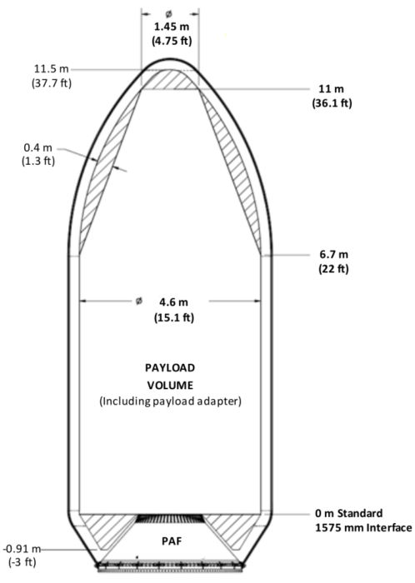
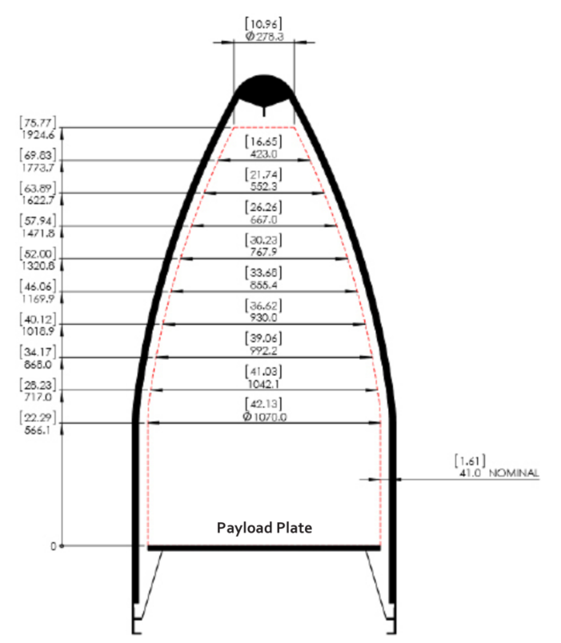
Launch Vehicle Selection and Interface
Mechanical Interface
※FALCON USER’S GUIDE JANUARY 2019
※PAYLOAD USER’S GUIDE JUNE 2019
항목 | SPACE X – Falcon9 | ROKET LAB - Electron | 비고
Fairing | 크기 : Ø4.6 X 11 (m) | 크기 : Ø1.07 X 1.9 (m)
Payload plate Interface | 업체에 문의 필요 | 업체에 문의 필요

Slide 69
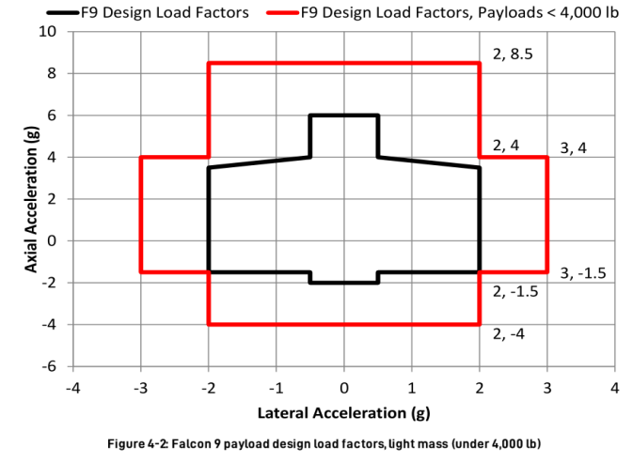
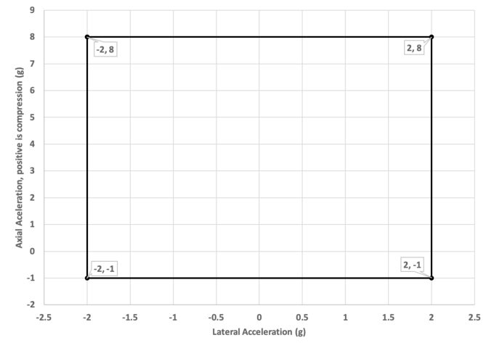
Launch Vehicle Selection and Interface
Environment Interface
규격 | SPACE X – Falcon9 | ROKET LAB - Electron | 비고
Load Factor
Sine Vibration |  | 매뉴얼에 항목 없음
Qualification : Limit levels x 1.25
Protoqualification : Limit levels x 1.25
Acceptance : Limit levels x 1.0
Frequency (Hz) | Acceleration (g)
5 | 0.5
20 | 0.8
35 | 0.8
35 | 0.6
75 | 0.6
85 | 0.9
100 | 0.9
Frequency (Hz) | Acceleration (g)
5 | 0.5
85 | 0.8
100 | 0.6
<Laterial Sine Vibration>
<Axial Sine Vibration>
Qualification : Limit levels x 1.25
Protoqualification : Limit levels x 1.25
Acceptance : Limit levels x 1.0

Slide 70
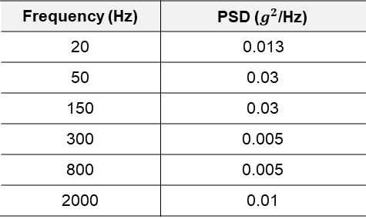
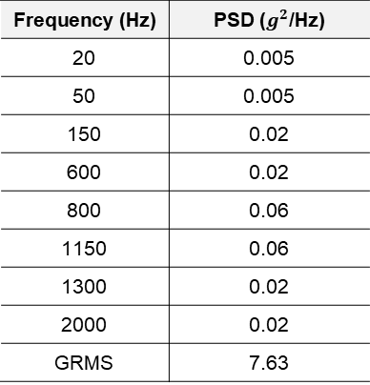
Launch Vehicle Selection and Interface
Environment Interface
규격 | SPACE X – Falcon9 | ROKET LAB - Electron | 비고
Random Vibration
Shock
Frequency (Hz) | PSD ($g^{2}$/Hz)
20 | 0.005
50 | 0.005
150 | 0.02
600 | 0.02
800 | 0.06
1150 | 0.06
1300 | 0.02
2000 | 0.02
GRMS | 7.63
Frequency (Hz) | PSD ($g^{2}$/Hz)
20 | 0.013
50 | 0.03
150 | 0.03
300 | 0.005
800 | 0.005
2000 | 0.01
Frequency (Hz) | SRS (g)
100 | 30
1000 | 1000
10000 | 1000
Frequency (Hz) | SRS (g)
100 | 50
900 | 700
10000 | 700

Slide 71
Launch Vehicle Selection and Interface
Environment Interface
규격 | SPACE X – Falcon9 | ROKET LAB - Electron | 비고
ACOUSTIC
Frequency (Hz) | Acoustic Limit Levels (P95/50), 60% Factor (DB)
25 | 126
100 | 130
125 | 130
200 | 130
315 | 127
400 | 124.5
630 | 118.5
1000 | 113
3150 | 106.5
5000 | 104.5
8000 | 102.5
10000 | 101.5
OASPL | 140.3
Frequency (Hz) | Acoustic Limit Levels (P95/50), 60% Factor (DB)
25 | 105
100 | 114
125 | 113
200 | 112
315 | 112
400 | 112
630 | 112
1000 | 113
3150 | 104
5000 | 101
8000 | 100
10000 | 100
OASPL | -

Slide 72
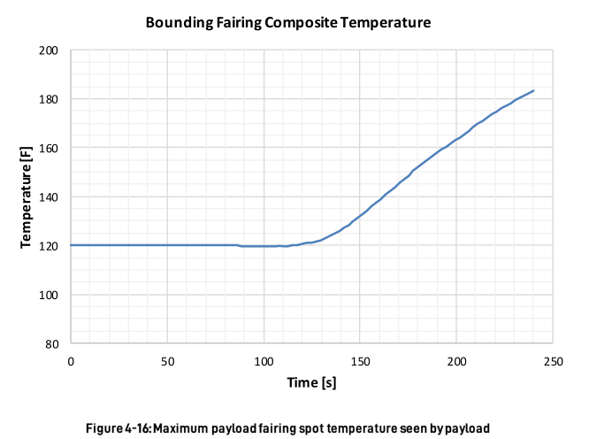
Launch Vehicle Selection and Interface
Thermal Condition
규격 | SPACE X – Falcon9 | ROKET LAB - Electron | 비고
Thermal condition | Thermal Vacuum 기준 | 매뉴얼에 항목 없음

Slide 73
Space to Ground Interface
S-band Interface

Slide 74
Space to Ground Interface
X-band Interface

Slide 75
EMI/EMC Design

Slide 76
Verification Plan
Overview

Slide 77
Verification Management
Requirement Verification Matrix (RVM) Scope
  System Specification
  System Level Interface Control Document
  Spacecraft Bus, Payload, Ground System Specification
  Spacecraft Bus Subsystem Specification
  Payload Subsystem Specification
Requirement Traceability Matrix (RTM) Scope
  System Specification
  System to Spacecraft Bus, Payload, Ground System Specification
  Spacecraft Bus to Subsystem Specification
  Payload to Subsystem Specification
Verification Test Matrix (VTM) Scope
  Satellite, STM, ETB
  Spacecraft Bus Units
  Payload Units

Slide 78
Requirement Verification Matrix
System
Req. Id | 항목 | Level | Phase | Verification Method |  |  |  |  | 비고
 |  |  |  | T | A | S | I | D
 | SAR 분해능 |  |  | √ | √
 | 고도 |  |  |  | √
 | 궤도 |  |  |  | √
 | 궤도당 최대 영상획득 시간 |  |  | √ | √
 | 관측 모드 |  |  | √ | √
 | 관측폭 |  |  | √ | √
 | 관측 경사각 |  |  | √ | √
 | SAR 영상자료저장 |  |  | √
 | SAR 영상자료전송 |  |  | √
 | 자료 암호화 |  |  | √
 | 이중화 |  |  | √
 | 편파 |  |  | √
 | 주파수 |  |  | √
 | Chirp 대역폭 |  |  | √
 | Chirp 생성 |  |  | √ | √
 | 소비전력 |  |  | √ | √
 | 무게 |  |  | √ | √
 | 크기 |  |  | √ | √
 | 환경조건 |  |  | √ | √

Slide 79
Requirement Verification Matrix
SAA
Req. Id | 항목 | Level | Phase | Verification Method |  |  |  |  | 비고
 |  |  |  | T | A | S | I | D
 | Frequency |  |  | √ | √
 | Bandwidth |  |  | √ | √
 | VSWR |  |  | √ | √
 | Gain |  |  | √ | √
 | Horizontal 3dB Half Power Beam Width |  |  | √ | √
 | Vertical 3dB Half Power Beam Width |  |  | √ | √
 | Horizontal Radiation Pattern |  |  | √ | √
 | Vertical Radiation Pattern |  |  | √ | √
 | Sidelobe Level |  |  | √ | √
 | Beam Squint Angle |  |  | √ | √
 | Aperture Phase Variation |  |  | √ | √
 | Aperture Amplitude Variation |  |  | √ | √
 | Gain |  |  | √ | √
 | Horizontal 3dB Half Power Beam Width |  |  | √ | √
 | Vertical 3dB Half Power Beam Width |  |  | √ | √
 | Horizontal Radiation Pattern |  |  | √ | √
 | Vertical Radiation Pattern |  |  | √ | √
 | Sidelobe Level |  |  | √ | √
 | Beam Squint Angle |  |  | √ | √
 | Aperture Phase Variation |  |  | √ | √
 | Aperture Amplitude Variation |  |  | √ | √

Slide 80
Requirement Verification Matrix

Slide 81
Requirement Traceability Matrix

Slide 82
Verification Test Matrix (VTM)

Slide 83
Product Assurance Requirements and Plan

Slide 84
PA General / QA Plan

Slide 85
Software QA

Slide 86
EEE Part

Slide 87
Material & Processes

Slide 88
Reliability

Slide 89
Contamination Control

Slide 90
Payload System

Slide 91
SAR Payload Major Requirements

Slide 92
Configuration

Slide 93
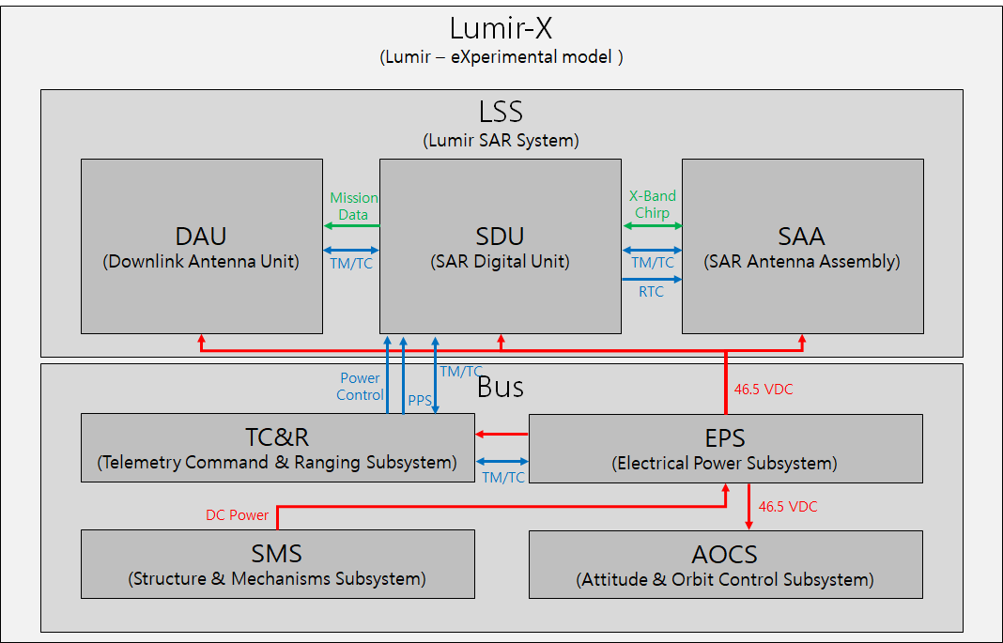
Function Block Diagram

Slide 94
SAR Payload Hardware Matrix

Slide 95
SAR Sensor Electronics

Slide 96
SAR Antenna Subsystem

Slide 97
Data Link Subsystem

Slide 98
Spacecraft Bus System

Slide 99
Spacecraft Bus Major Requirements

Slide 100
Configuration

Slide 101
Function Block Diagram

Slide 102
Spacecraft Bus Hardware Matrix

Slide 103
Mechanical Design Integration

Slide 104
Electrical Design Integration

Slide 105
Structures and Mechanism Subsystem

Slide 106
Thermal Control Subsystem

Slide 107
Attitude and Orbit Control Subsystem

Slide 108
Propulsion Subsystem

Slide 109
Telemetry, Command and Ranging Subsystem

Slide 110
Electrical Power Subsystem

Slide 111
Flight Software Subsystem

Slide 112
Ground Segment

Slide 113
Architecture

Slide 114
Mission Control Element

Slide 115
Image Reception and Processing Element

Slide 116
Calibration and Validation Element

Slide 117
SAR Processor

Slide 118
Assembly, Integration, and Test

Slide 119
Electrical Test Bed

